Slide 1
Movie Recommender System
Aayush Grover, Alimulla Shaik , Camilla Lambrocco

Slide 2
Objective
The movie industry is a market of great economic interest. We aim to develop a system able to provide statistics on ratings and trends such that the public can rely on a valuable movie ranking chart.
We will analyze the data depending on genre, year and ratings of the numerous people that throughout the years expressed their opinion on the selected movies.to movies to be analysed.

Slide 3
Data Set
MovieLens
1 M ratings, 7000 movies by 8000 users

Slide 4
Data Mining Techniques
Languages and Tools used.
K means clustering
Alternative Least Square Algorithm
Decision Tree
Logistic Regression
Analysis
R
Scala
Hadoop + Spark

Slide 5
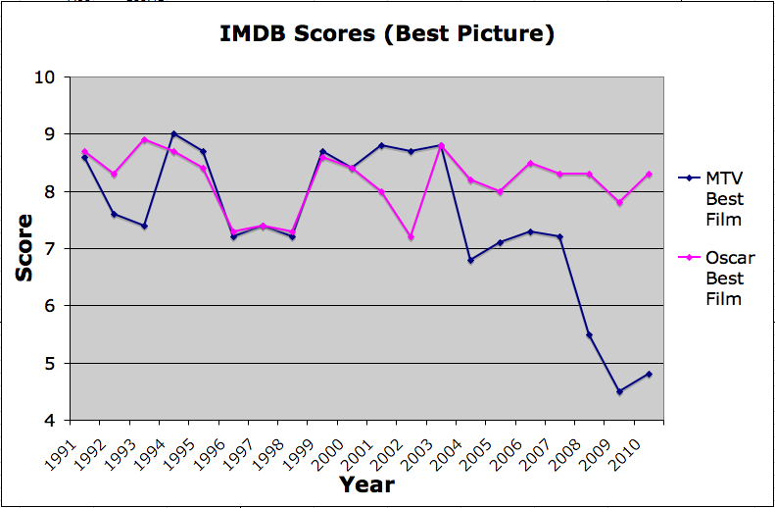
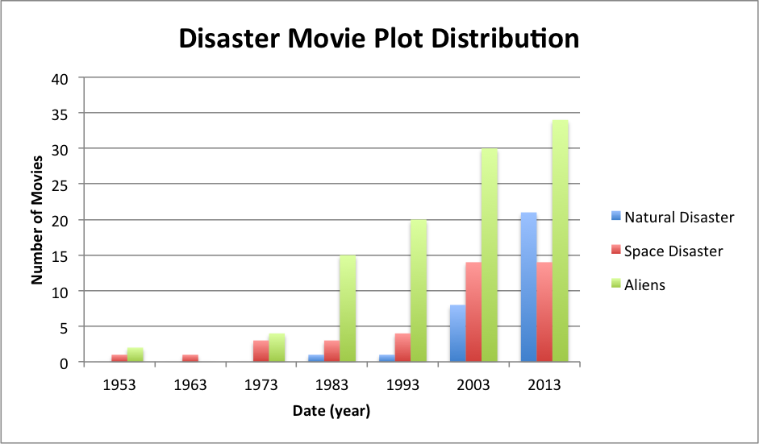
How?
DataSet inspection
missing data?
outliers?
Inspection to see consistency
DataSet to DataFrame
Division of DataFrame in 70/30
Perform modeling of 70%
Visualization
Predictive analysis
Test prediction from model on 30%

Slide 6
Prospective ENGINE
By collecting information about movie ratings we will be able to understand the trend, by year and genre, of the movie industry. Our research aims to provide the public with information about ratings that comes from multiple sources.
Finally, the project will allow us to acquire real word experience of data modeling of a large dataset market and understand the complexity of the process.

Slide 7
Data Pre-processing and EDA
Progress
Data Pre-processing
EDA
70% of time till now is consumed in Data PreProcessing and Exploration Data Analysis.
Found some pretty interesting patterns by doing EDA. Let’s look at the graphs.

Slide 8
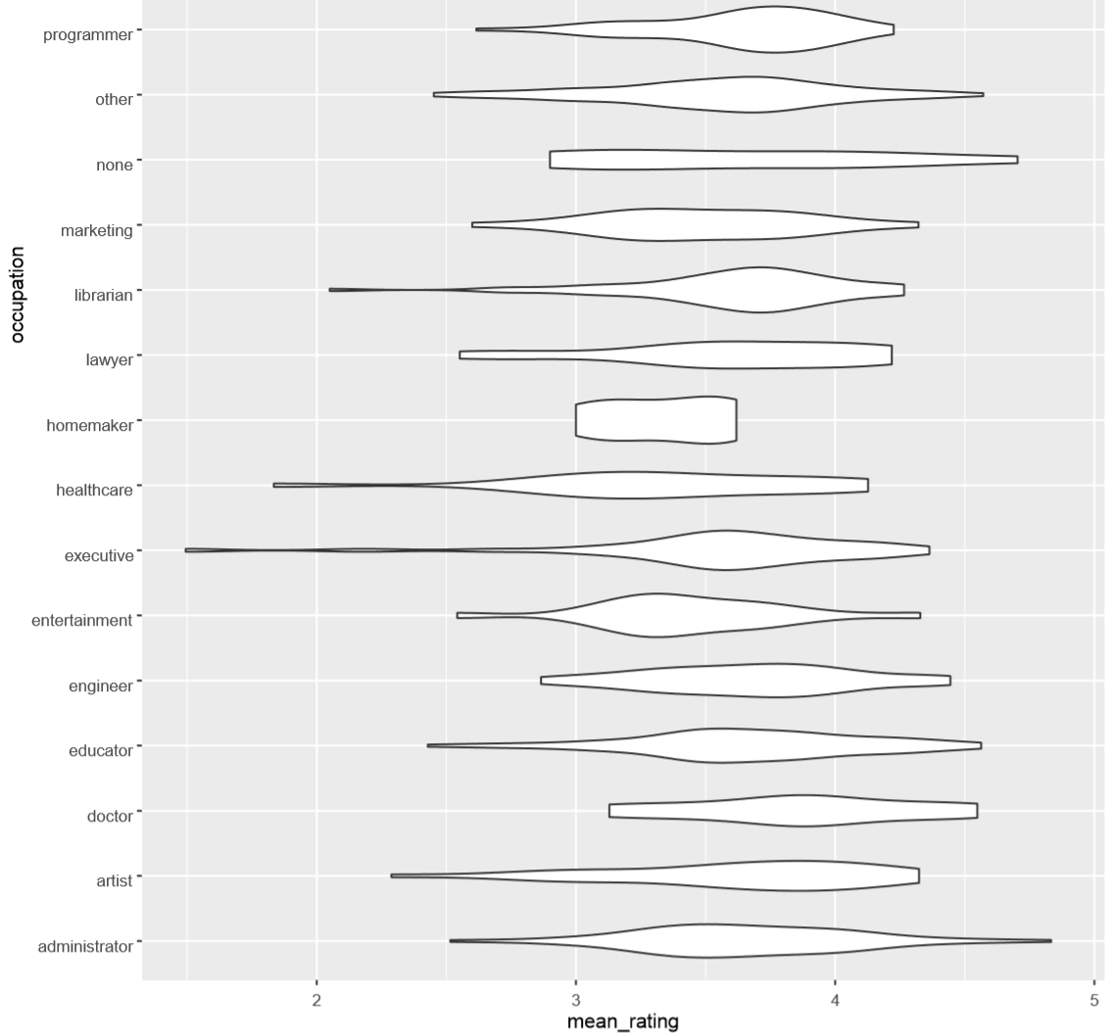

Slide 9
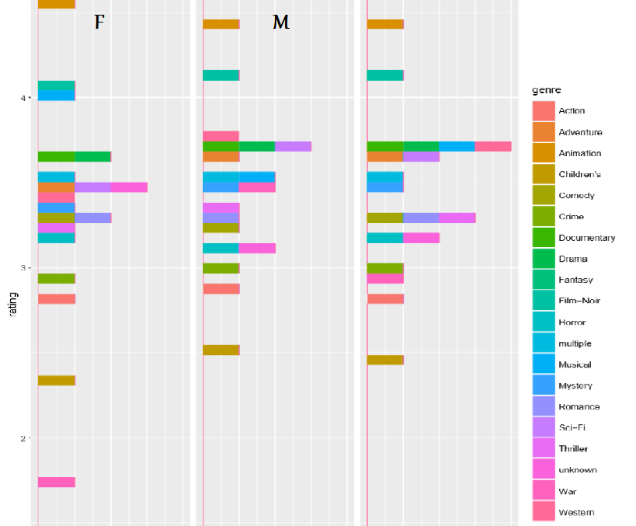

Slide 10
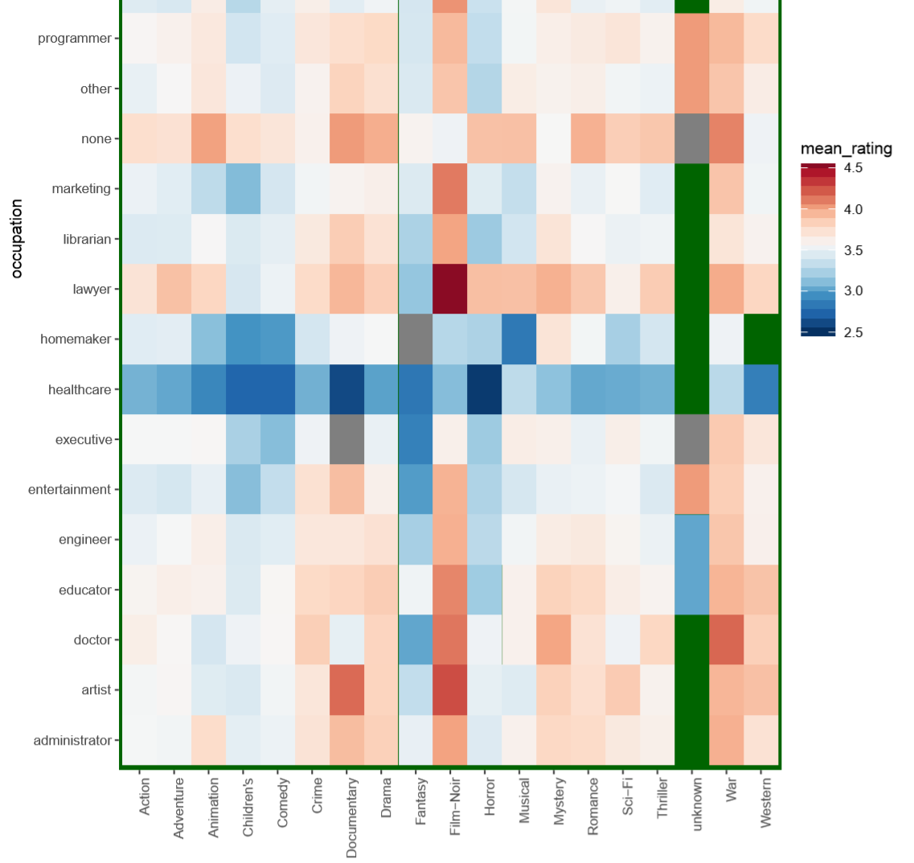

Slide 11
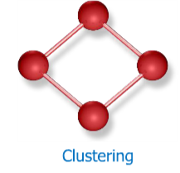
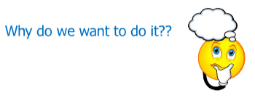
Clustering
Progress
Organizing data into clusters such that there is:
High intra cluster similarity
Low inter cluster similarity
Informally finding natural groups among objects.

Slide 12
Clustering
Progress
Clustering?
Organizing objects such that:
High intra-cluster similarity
Low inter-cluster similarity

Slide 13
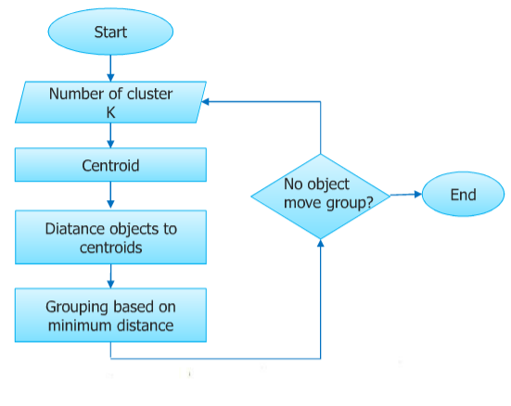
K-Means Clustering
Progress
Iterate until stable
(cluster centers converge):
Determine the centroid co-ordinate
Determine the distance of each object to the centroids
Group the object based on minimum distance(find the closest centroid)

Slide 14
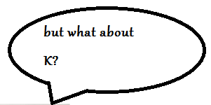

K-Means Clustering
Progress
K-Means Clustering

Slide 15
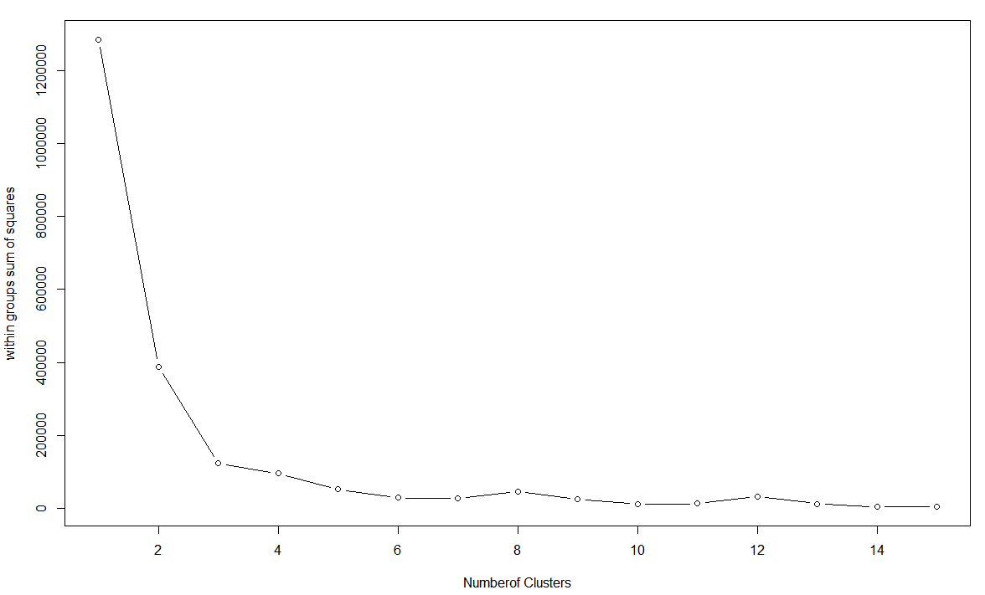
ELBOW CURVE TO DETERMINE THE NO. OF CLUSTERS (ex. SCI-FI genre)

Slide 16
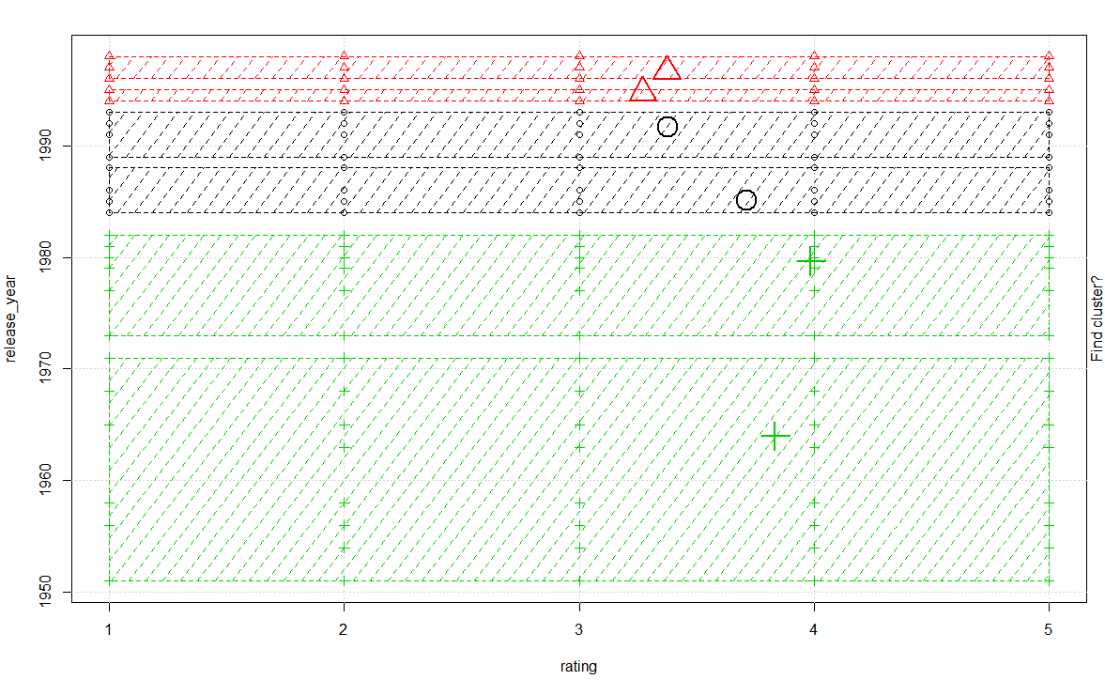
SCI-FI GENRE
Similarly, performed clustering for all 13 genres.

Slide 17

EVALUATION:
Calculated Cluster Strength for each of the clusters.
A good cluster has cluster strength > 90%
All of the cluster strengths came out to be 92-97%
between_ss -> between sum of squares; gives us the distance across the clusters.
withn_ss -> within sum of squares; and is the total distance between all the points within a cluster with the cluster center. It captures the intra cluster similarity.
tot.withinss ->”Total within sum of squares” = sum(withinss)
total_ss -> tot.withinss + between_ss

Slide 18
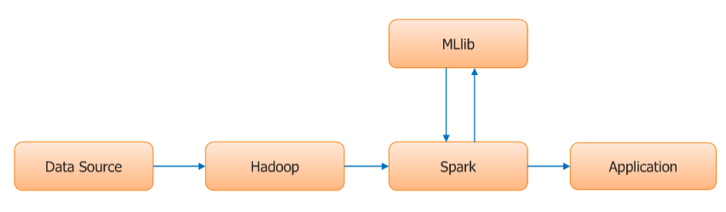
MOVIE RECOMMENDATION ENGINE USING ALTERNATING LEAST SQUARE ALGORITHM:

Slide 19
Used the integration of Hadoop & Spark to implement the recommendation engine.
Input stored in HDFS(Hadoop Distributed File System).
Leveraged the Machine Learning library(MlLib) of Spark to implement the recommendation engine based upon Alternating least square algorithm.
Spark job developed in Scala.
Model based upon supervised learning. Trained the model with 70% of the data and tested the model with the remaining 30% of the data.

Slide 20
Extracted the rating info from DataSet.
Created a rating object out of it using the case rating array.
Using train method, trained the model leveraging ALS library by passing 4 parameters to train method: rating object, no. of iterations, depth, and precision.
Call the recommendProducts method by pssing the parameters userId and K.
Call the predict method by passing the parameters UserId, MovieId to predict what rating this user would give to this movie.

Slide 21
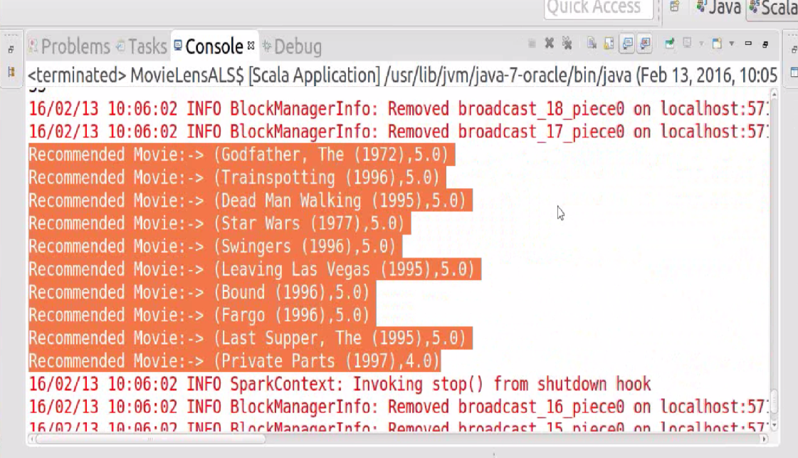
Entered the userId 487 and value = 10. For this the recommender recommended the top 10 movies for the user.

Slide 22
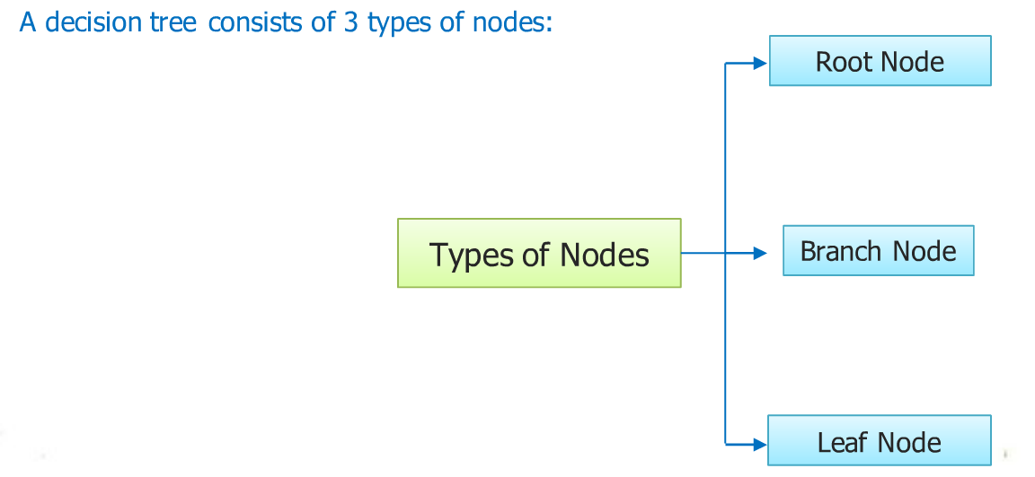
Decision Tree
Progress
A decision tree is a tree-like structure in which internal node represents test on an attribute, each branch represents outcomes of test and leaf node represents class label.

Slide 23
Decision Tree
Progress
Basic algorithm - greedy algorithm
Tree construction: top-down recursive divide-and-conquer
Training example position: root
Attributes: categorical
Input data: partitioned recursively (based on attribute)
Selection: heuristic and/or statistical measure (i.e information gain)
Condition for stopping partitioning
Samples at node belong to same class
No remaining attributes for further partitioning (major voting is employed for leaf classification)
No samples left

Slide 24
Decision Tree
Progress
How do we select the attribute ?
As previously stated the attributes to be selected are based on heuristic and/or statistical measure (i.e information gain).
Procedure?
Calculate information gain
Maximum information gain attribute becomes the split parameter
Why?
We want to maximize the gain of information from the pre-processed data.

Slide 25
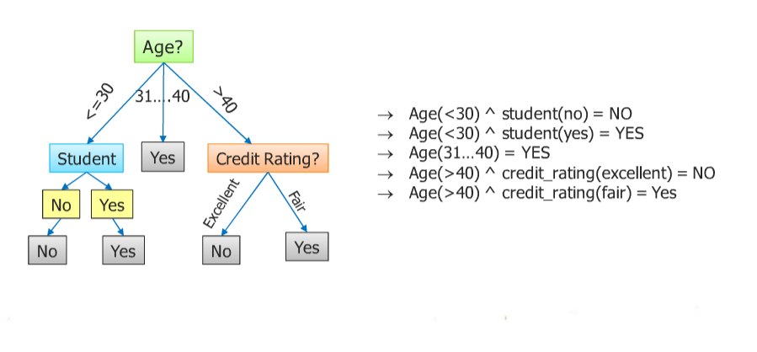
Decision Tree
Progress
Classification rules

Slide 26
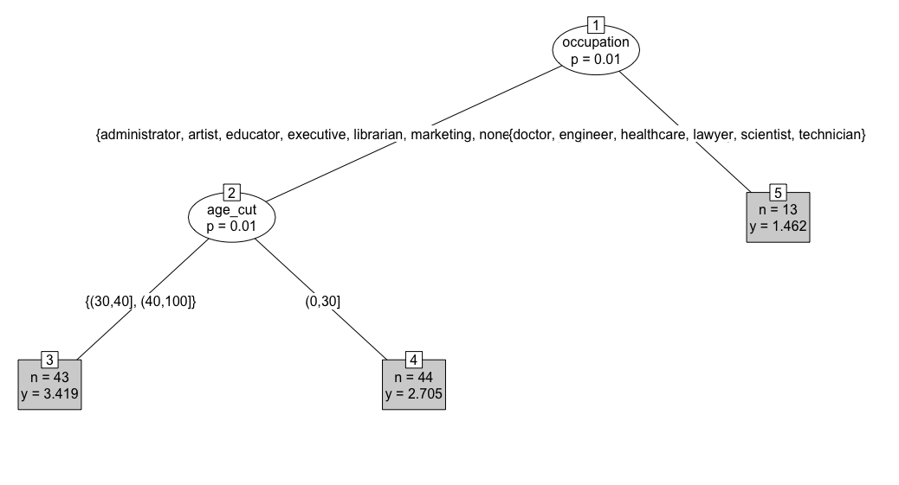
Decision Tree - Interpreting results
Visualization: simple
p = 1-mincriterion
n = datapoints
y = class value
rating

Slide 27
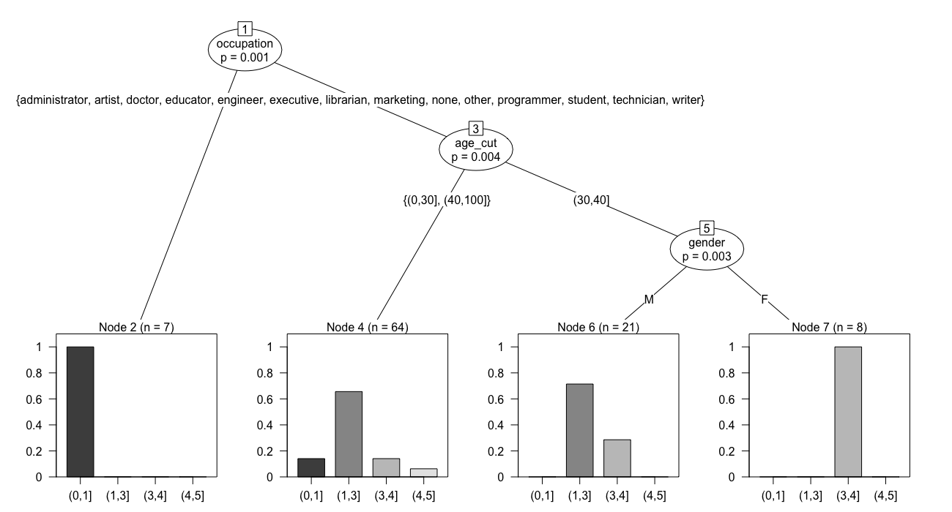
Decision Tree - Interpreting results
Visualization: complex
Attributes?
SSE?
Variance?
Mean?

Slide 28
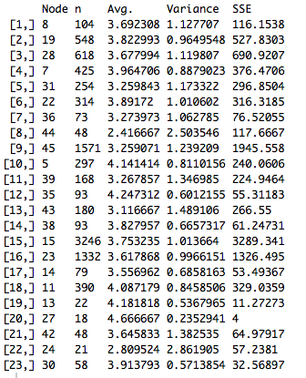
Decision Tree - Interpreting results
Visualization: complex
Attributes: strong dependance
SSE: discrepancy between the data and an estimation model
Variance: distribution from the mean
Average: mean

Slide 29
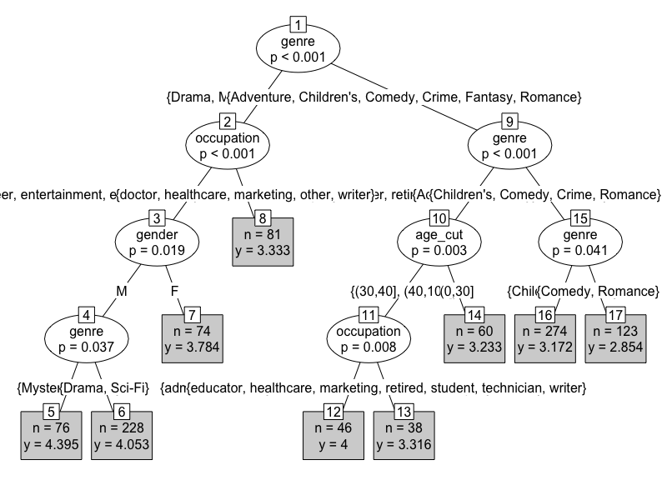
Decision Tree - Interpreting results
Difficulties
Poor rendering
Dense tree: difficult to analyze
Visualization requires custom features

Slide 30
Decision Tree - Interpreting results
Random Forest
Progress
Tried several attribute combination
Splitting criterion changes!
Error too high!
Tried filtering data and rearranging attribute but no luck!

Slide 31
Logistic Regression
•Determine the relationship between the categorical dependent variable and multiple independent variables.
•Parameters to interpret from the logistic analysis are listed below.
•estimate coefficient
•standard error – useful to determine confidence intervals
•Z-value - big in magnitude indicates variable matters
•P-Value – Indicates the variables that add meaningful value to our model
•Deviance Table analysis
•Parameters to interpret from this analysis are listed below.
•Null deviance and the residual deviance - determines how a model is doing against the null model.
•chi-square value – to test that our model resulted outcomes with high probability.

Slide 32
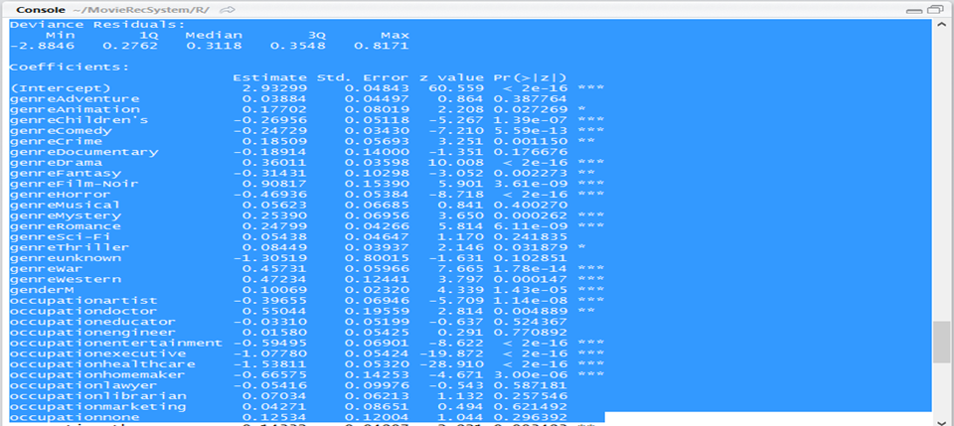
Logistic Regression Report

Slide 33
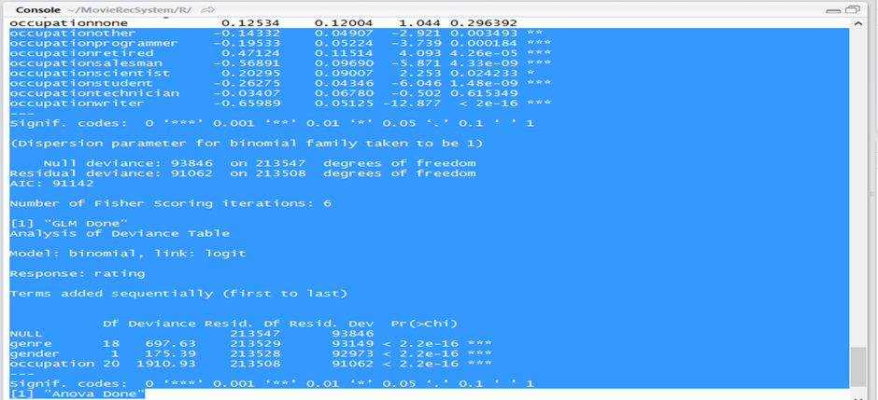
Logistic Regression Report – Continued.

Slide 34
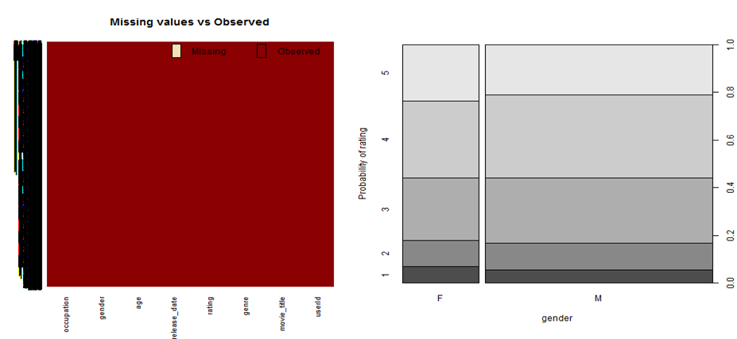
Logistic Regression - Graphs

Slide 35
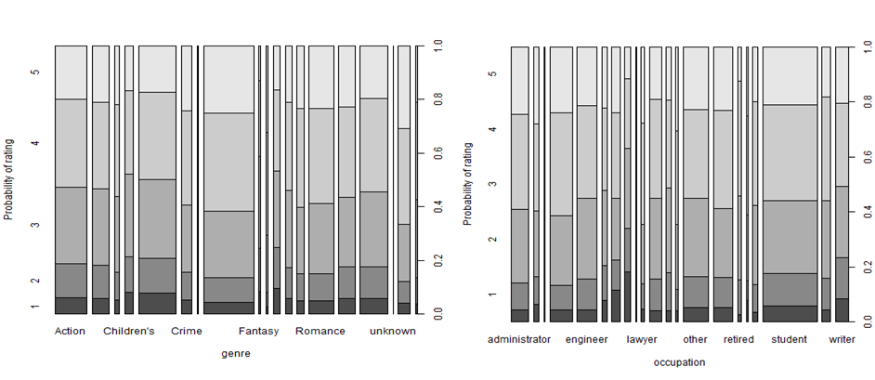
Logistic Regression - Graphs

Slide 36
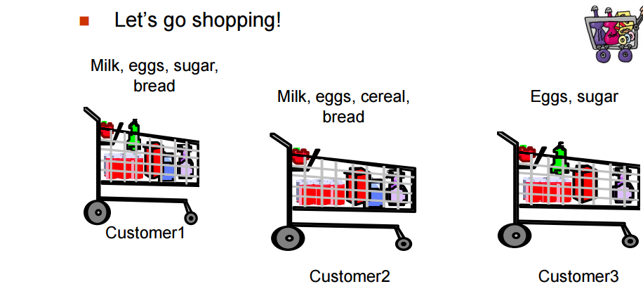
Association Rules
Goal:
To find frequent or interesting patterns, associations, correlations or causal structures among sets of items or objects in databases or other information repositories.
To describe relationships in terms of association rules X⇒Y
Many measures of interest available but the two most used are Support and Confidence.

Slide 37
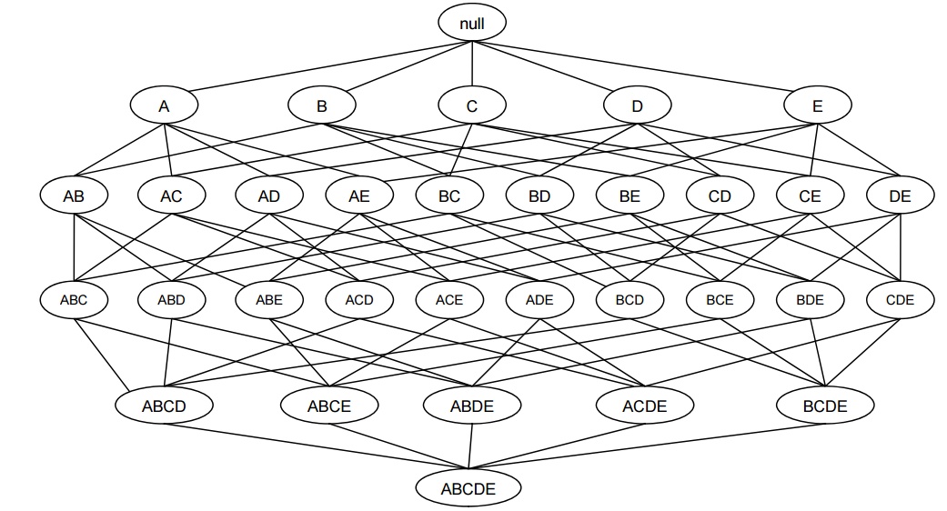
Apriori Algorithm
Is the most influential association rule miner algorithm.
Algorithm has below two steps,
Generate all frequent itemsets whose support ≥ minSup
Use only frequent itemsets to generate association rules.
Procedure:
Apply apriori algorithm to find interesting patterns.
Can predict data based on interesting patterns found on overall data.
For ‘d’ items, ‘(2^d - 1)’ itemsets are possible.
Do we need to generate them all?

Slide 38
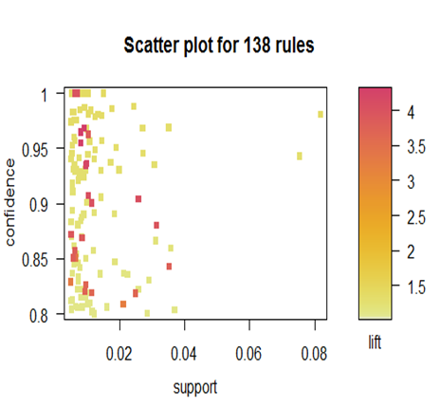
Association Rule Mining Results
I have applied association rule mining on our movie data set but we did not get any interesting patterns which can be useful for this project to suggest new movie recommendations to the user.

Slide 39
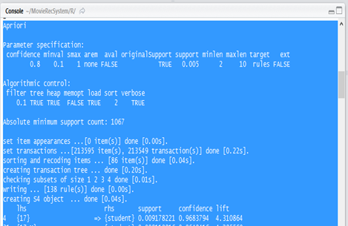
Association Rule Mining Results Continued.

Slide 40
Reference to DataSets
MovieLens http://grouplens.org/datasets/movielens/

